Slide 1
Symmetric Matrices and Quadratic Forms
6.2 Quadratic Forms
Bumhee Cho

Slide 2
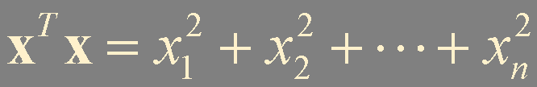
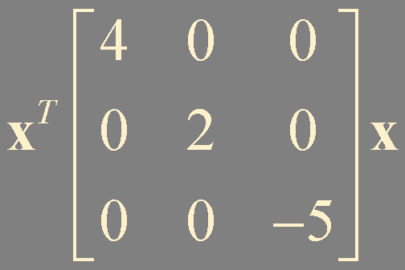
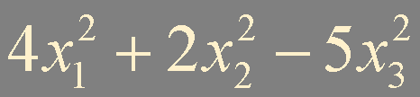
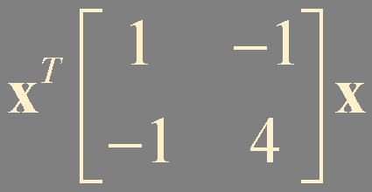
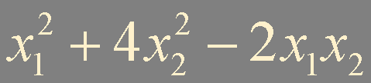


Quadratic Form
signal processing
physics
differential geometry
economics
statistics
...
a polynomial with terms all of degree two
A is n × n symmetric matrix
the matrix of the quadratic form

Slide 3

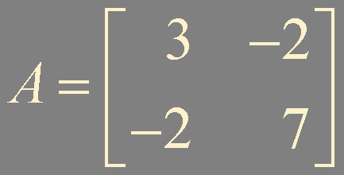

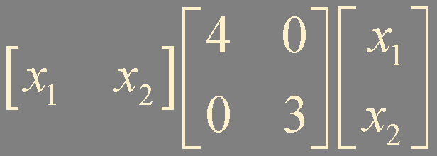
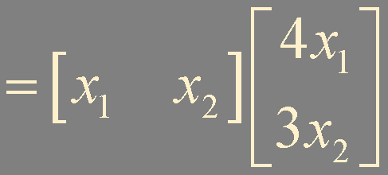
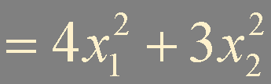
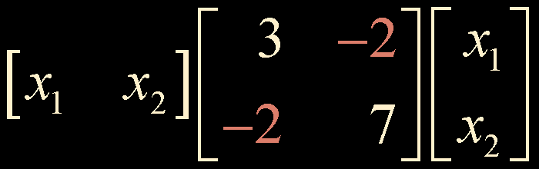
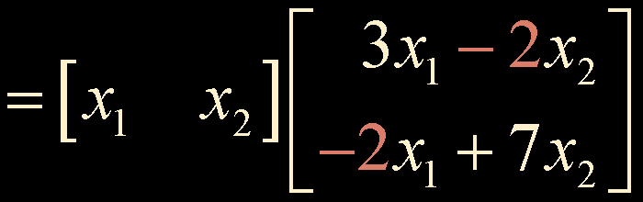

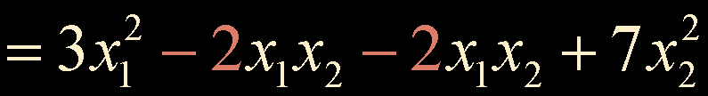
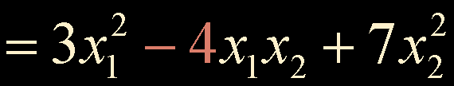
?
!
Let x = (x₁, x₂), Compute x^{T}Ax for the following matrices:
a. b.
Example 1

Slide 4
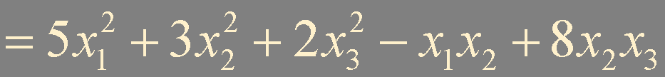
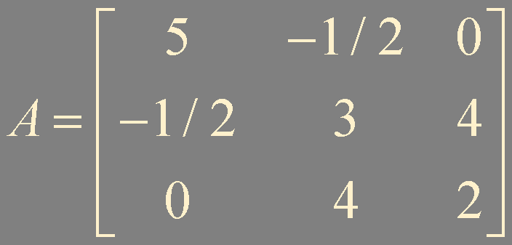
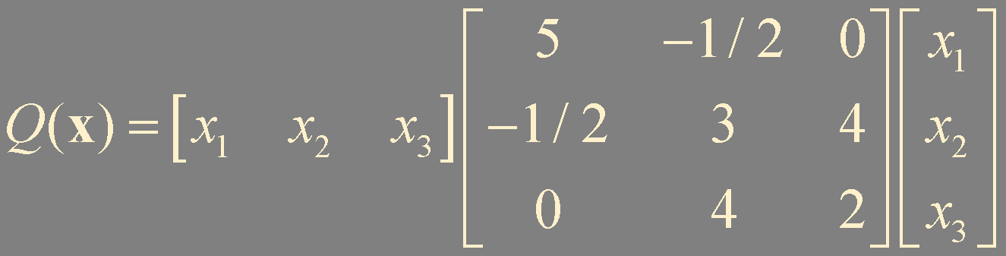
?
!
For x in ℝ³, let Q(x) . Write this quadratic form as x^{T}Ax
Example 2
diagonal entries:
5, 3, and 2
(1, 2)- and (2, 1)-entries:
-1/2
(2, 3)- and (3, 2)-entries:
4

Slide 5




Change of Variable in a Quadratic Form
x = Py
y = P⁻¹x
P is n × n invertible matrix
P = [ b₁ b₂ ⋯ b_{n} ]
x = y₁b₁ + y₂b₂ + ⋯ + y_{n}b_{n}
y is the coordinate vector of x relative to
the basis of ℝ^{n} determined by the columns of P
A is symmetric matrix
A is orthogonally diagonalizable
A = PDP^{T} = PDP⁻¹
P^{T}AP = D
no cross-product terms

Slide 6
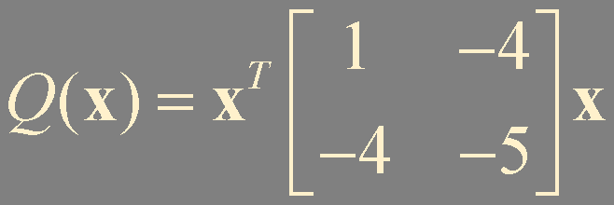
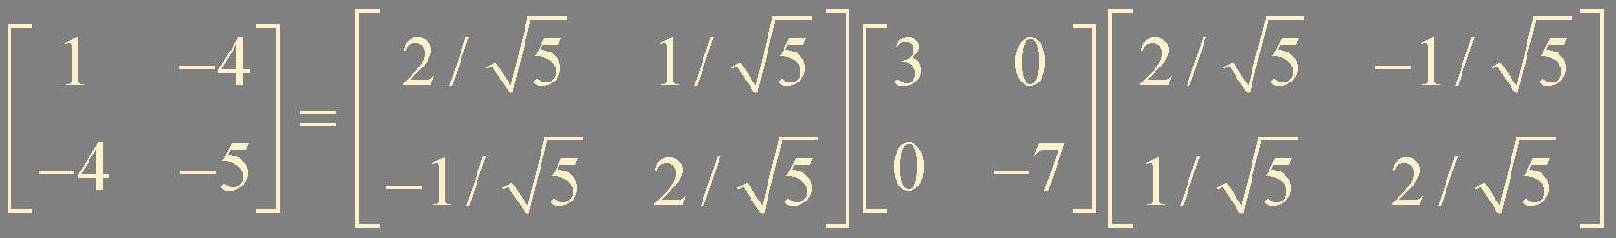
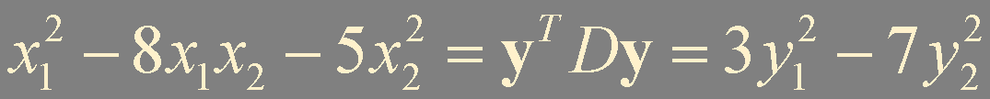
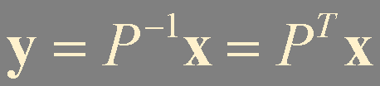
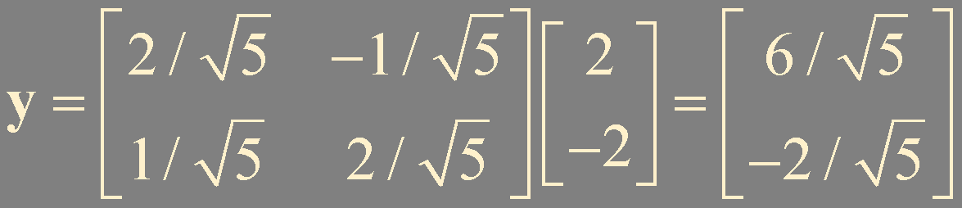
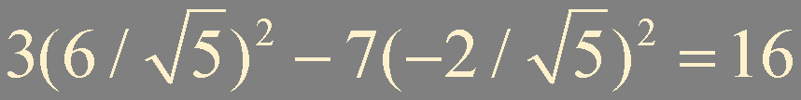
?
!
Make a change of variable that transforms the quadratic form
into a quadratic form with no cross-product
term.
Example 3
orthogonally diagonalize
vb
vb
x = (2, -2)

Slide 7

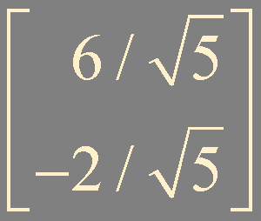
x^{T}Ax
x
ℝ²
P
ℝ
0
16
y
y^{T}Dy
ℝ²
spanned by the columns of P

Slide 8
Theorem 4. The Principal Axes Theorem
Let A be an n × n symmetric matrix.
Then there is an orthogonal change of variable, x = Py, that transforms the quadratic form x^{T}Ax into a quadratic form y^{T}Dy with no cross-product term.
the columns of P are called the principal axes
orthonormal basis of ℝ^{n}

Slide 9


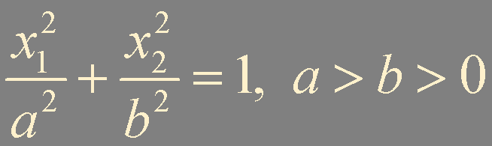
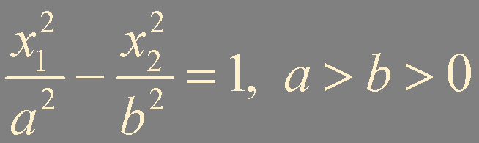
A Geometric View of Principal Axes
A is 2 × 2 invertible symmetric matrix
Q(x) = x^{T}Ax = c
ellipse
hyperbola
two intersecting lines
a single point
no points at all
when A is a diagonal matrix
x₂
x₂
hyperbola
ellipse
b
b
x₁
a
x₁
a

Slide 10
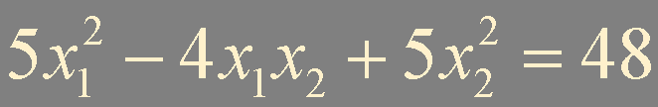
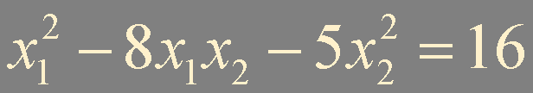
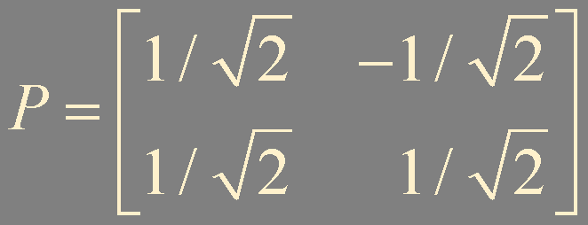
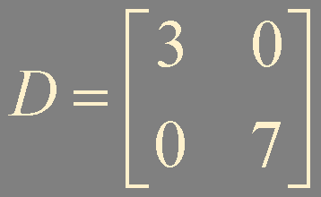
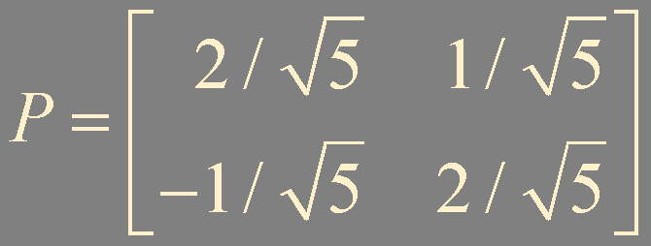
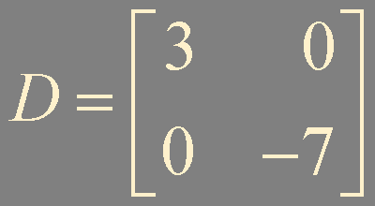
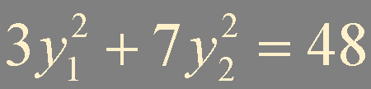
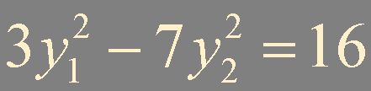






y₂
x₂
y₁
x₂
y₂
x₁
x₁
y₁

Slide 11
Classifying Quadratic Forms
Q(x) = x^{T}Ax is a real-valued function with domain ℝ^{n}
positive definite if Q(x) > 0 for all x ≠ 0
negative definite if Q(x) < 0 for all x ≠ 0
indefinite if Q(x) assumes both positive and negative values
positive semidefinite if Q(x) ≥ 0 for all x
negative semidefinite if Q(x) ≤0 for all x

Slide 12
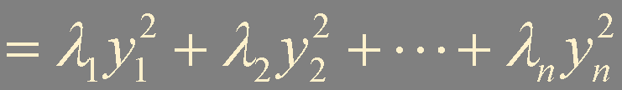
Theorem 5. Quadratic Forms and Eigenvalues
Let A be an n × n symmetric matrix. Then a quadratic form x^{T}Ax is:
a. positive definite if and only if the eigenvalues of A are all positive,
b. negative definite if and only if the eigenvalues of A are all negative, or
c. indefinite if and only if A has both positive and negative eigenvalues.
positive semidefinite
By Theorem 4. The Principal Axes Theorem
nonnegative
Cholesky
factorization
Q(x) = x^{T}Ax
= y^{T}Dy
negative semidefinite
A = R^{T}R or
A = LL^{T}
nonpositive

Slide 13
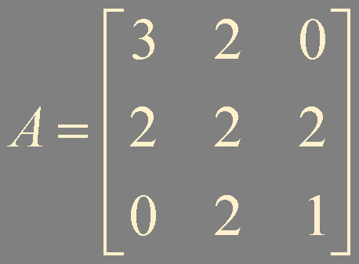
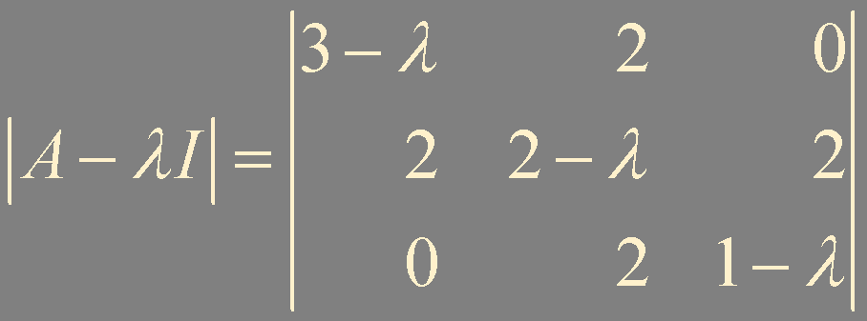
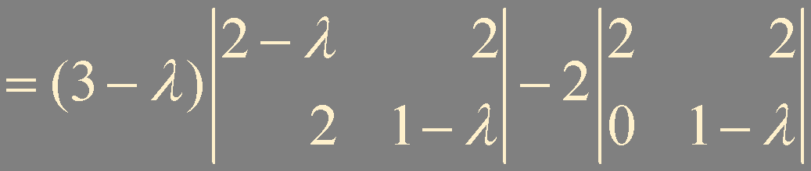

?
Example 4
!
Is positive definite?
indefinite

Slide 14
Summary
Quadratic form
Change of variable
Principal axes
Classifying quadratic forms

